Slide 1

Predicting Diabetes Mellitus With ML Technique
Submitted To:- Submitted by : -
Mr. Sanjay Madan Arpit Shrivastav
Akshant Chandel
Vivek Thakur

Slide 2
Content
Introduction
Problem Statement
Objectives
Dataset Description
Workflow
Technologies
Data Preprocessing
Data Visualization
Comparison Table
Result
Conclusion

Slide 3

Introduction
Diabetes is the fast growing disease among the people even among the youngsters.
Diabetes is a chronic disease with the potential to cause a worldwide health care crisis. Diabetes mellitus or simply diabetes is a disease caused due to the increase in level of blood glucose.
Diabetes is high blood sugar, with symptoms including increased thirst, increased hunger, weight loss and frequent urination.

Slide 4
Problem Statement
Patients with the potential of diabetes have to go through a series of tests and exams to diagnose the disease properly.
These tests may include redundant or unnecessary medical procedures, which lead to intricate complications and wastage of time & resources.

Slide 5
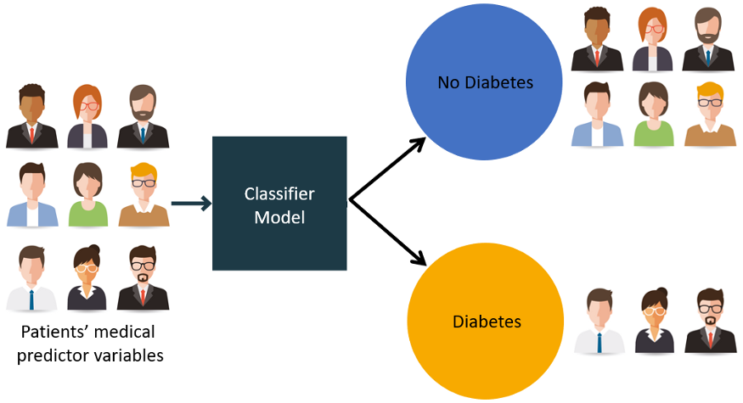
Objectives
The objective of this diabetes dataset is to predict whether patient has diabetes or not.
Predictor variables includes pregnancies, glucose, blood pressure, skin thickness, BMI, insulin, diabetes pedigree function, age and outcomes.
Here 0 means No diabetes, 1 means diabetes.

Slide 6
Dataset Description
The dataset has 8 columns and 769 rows in the dataset.
The dataset consists of several medical predictor (independent) variables and one target variable (outcome).
Dataset URL: https://www.kaggle.com/diabetes

Slide 7
Work Flow
Data Collection
Preprocessing Data
Building Model
Training
Testing
Output

Slide 8
Technologies
Libraries Used:-
Numpy
Pandas
Seaborn
Matplotlib
Various Classifiers that have been used in this study are:-
Decision Tree
Random Forest
Support Vector Machine (SVM)

Slide 9
Pre-processing
If the data collected contains any missing attributes or attribute values, contains noisy, outliers, duplicate or wrong data, then resultant accuracy will be depleted.
Moreover, the inconsistencies in the collected data may also affect the subsequent work.
That’s why we have applied pre-processing on the gathered data.

Slide 10
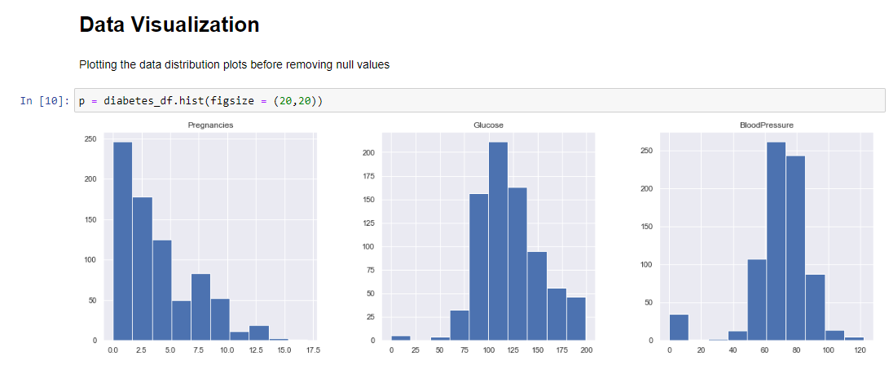
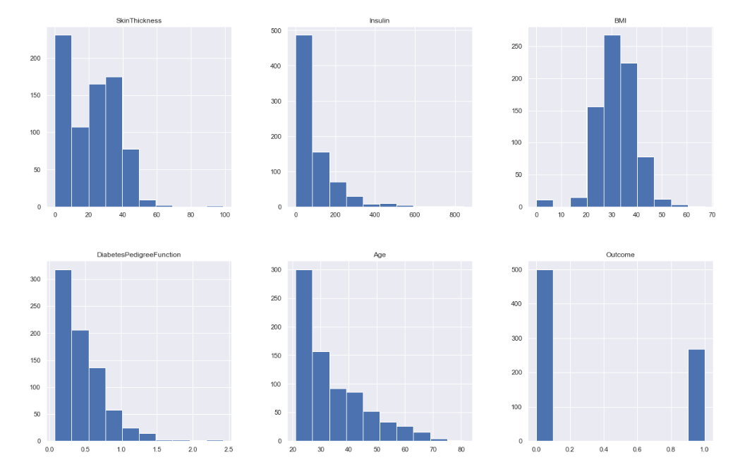
Data Visualization

Slide 11
Comparison Table
MODEL | Precision | Recall | Accuracy | F1-Score
Random Forest | 0.75 | 0.77 | 0.76 | 0.77
SVM | 0.74 | 0.69 | 0.74 | 0.70
Decision Tree | 0.77 | 0.84 | 0.71 | 0.78

Slide 12
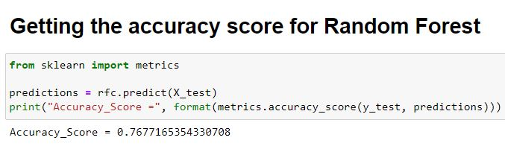
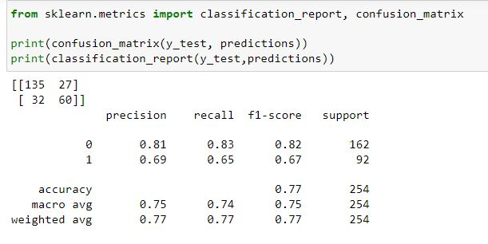
Result

Slide 13
Conclusion
The main aim of this project was to design and implement Diabetes Prediction Using Machine Learning Methods and Performance Analysis of that methods and it has been achieved successfully.
The proposed approach uses various classification and ensemble learning method in which SVM, Random Forest, Decision Tree are used. And 77% classification accuracy has been achieved.

Slide 14
THANK YOU

